Slide 1
Object-Oriented Programming
- Classes, Objects Methods, Strings
Based on slides from Deitel & Associates, Inc.
Revised by T. A. Yang

Slide 2
Outline
Classes
Objects
Methods
Parameters
double primitive type
GUI dialog boxes

Slide 3
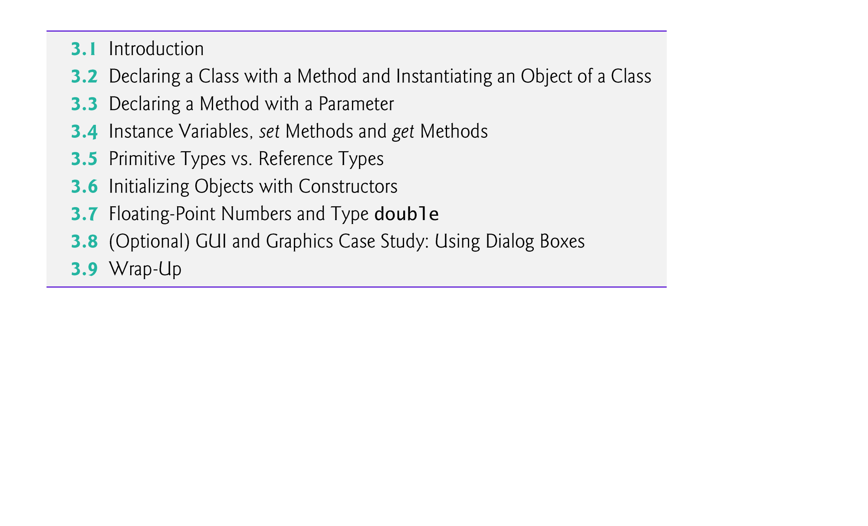

Slide 4
3.2 Declaring a Class with a Method and Instantiating an Object of a Class
Each class declaration that begins with keyword public must be stored in a file that has the same name as the class and ends with the .java file-name extension.
Keyword public is an access modifier.
Indicates that the class is “available to the public”
W/o the keyword public, the class is ‘package-private'
Modifier | Class | Package | Subclass | World
public | Y | Y | Y | Y
protected | Y | Y | Y | N
no modifier (package-private) | Y | Y | N | N
private | Y | N | N | N
class
source: http://download.oracle.com/javase/tutorial/java/javaOO/accesscontrol.html

Slide 5
Methods
The main method is called automatically by the Java Virtual Machine (JVM) when you execute an application.
Normally, the calling method must call methods explicitly to tell them to perform their tasks.
A public method is “available to the public”
It can be called from methods of other classes.
Four different access modifier for methods
The return type specifies the type of data the method returns after performing its task.
Return type void indicates that a method will perform a task but will not return (i.e., give back) any information to its calling method when it completes its task.

Slide 6
Methods (cont.)
By convention, method names begin with a lowercase first letter and subsequent words in the name begin with a capital letter.
Empty parentheses after the method name indicate that the method does not require additional information to perform its task.
Together, everything in the first line of the method is typically called the Method header
Every method’s body is delimited by left and right braces.
The method body contains one or more statements that perform the method’s task.

Slide 7
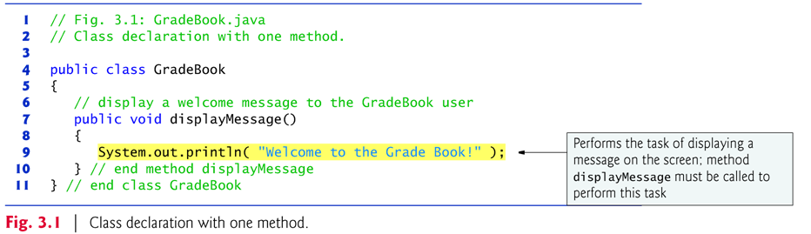
Example Class Definition: GradeBook.java

Slide 8
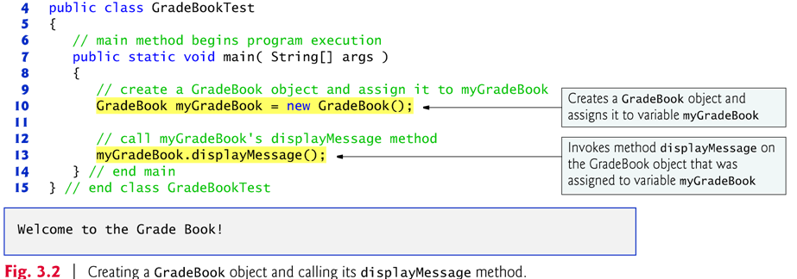
Use class GradeBook in an application: GradeBookTest.java
Class GradeBook is not an application because it does not contain main.
Can’t execute GradeBook; will receive an error message like: Exception in thread "main" java.lang.NoSuchMethodError: main
Must either declare a separate class that contains a main method or place a main method in class GradeBook.
Use a separate class containing method main( ) to test each new class.
Some programmers refer to such a class as a driver class.

Slide 9
Compiling an Application with Multiple Source Files:
Compile the classes in Fig. 3.1 and Fig. 3.2.
Type the command
javac GradeBook.java GradeBookTest.java
If the directory containing the application includes only this application’s files, you can compile all the classes in the directory with the command
javac *.java

Slide 10
A static method (such as main) is special.
It can be called without first creating an object of the class in which the method is declared.
c.f., instance method: Typically, you cannot call a method that belongs to another class until you create an object of that class.
Declare a variable of the class type.
Each new class you create becomes a new type that can be used to declare variables and create objects.
You can declare new class types as needed; this is one reason why Java is known as an extensible language.

Slide 11
Creating an instance out of a class:
Keyword new creates a new object of the class specified to the right of the keyword.
Used to initialize a variable of a class type.
The parentheses to the right of the class name are required.
Parentheses in combination with a class name represent a call to a constructor, which is similar to a method but is used only at the time an object is instantiated.

Slide 12
Calling a method:
Variable name followed by a dot separator (.), the method name and parentheses.
Calling a method causes the object to perform its task defined in that method.
Calling the main method:
Any class can contain a main method.
The JVM invokes the main method only in the class used to execute the application.
If multiple classes that contain main, then one that is invoked is the one in the class named in the java command.

Slide 13
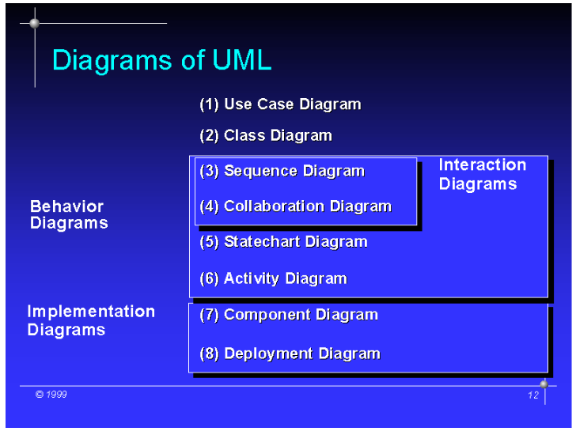
UML Class Diagram - One of the diagrams in UML
Source: http://ias.uni-klu.ac.at/projects/uml/ECOOP99/sld012.htm

Slide 14
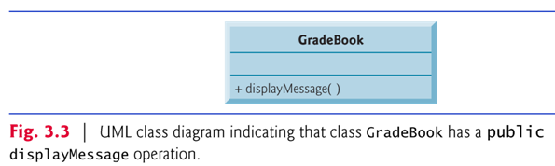
Figure 3.3: UML class diagram for class GradeBook.
Each class is modeled in a class diagram as a rectangle with three compartments.
Top: contains the class name centered horizontally in boldface type.
Middle: contains the class’s attributes, which correspond to instance variables.
Bottom: contains the class’s operations, which correspond to methods.
Operations are modeled by listing the operation name preceded by an access modifier (in this case +) and followed by a pair of parentheses.
The plus sign (+) corresponds to the keyword public.
#: protected -: private

Slide 15
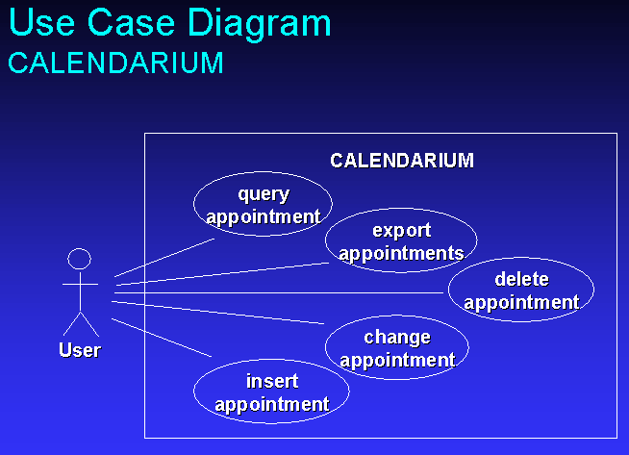
More resources for UML
http://sce.uhcl.edu/yang/teaching/UML_Resources.html
A sample Use Case Diagram
http://ias.uni-klu.ac.at/projects/uml/ECOOP99/sld022.htm

Slide 16
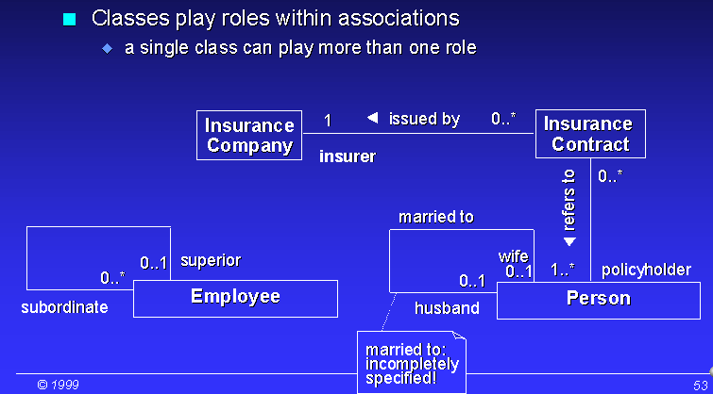
Associations between Classes
Source: http://ias.uni-klu.ac.at/projects/uml/ECOOP99/sld053.htm

Slide 17
3.3 Declaring a Method with a Parameter
Parameter: Additional information a method needs to perform its task.
A method can require one or more parameters that represent additional information it needs to perform its task.
Defined in a comma-separated parameter list
Located in the parentheses that follow the method name
Each parameter must specify a type and an identifier.
A method call supplies values — called arguments — for each of the method’s parameters.

Slide 18
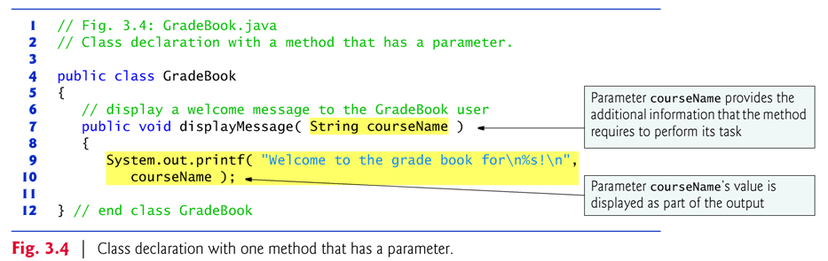
Revised GradeBook.java (GradeBook3_4.java)
Revised GradeBookTest.java
(GradeBookTest3_4.java)

Slide 19
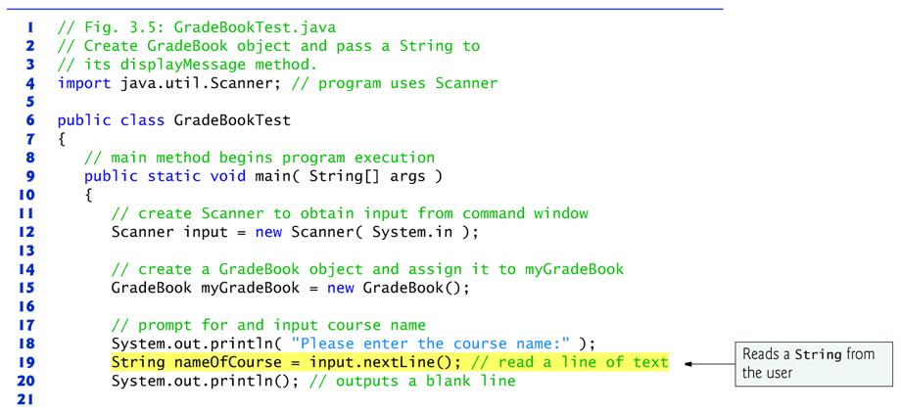
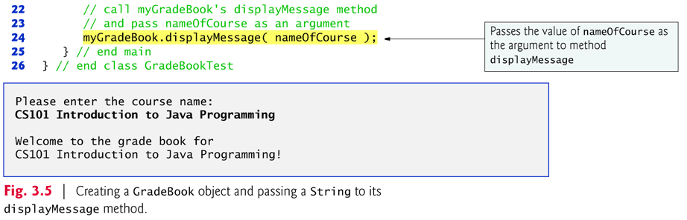

Slide 20
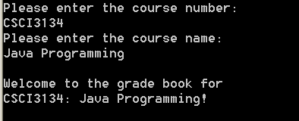
Exercise
Revise the programs in Figures 3.4 and 3.5, such that courseNumber and courseName are entered and processed as two different variables.
e.g., course number: CSCI3134
Course name: Java Programming

Slide 21
Scanner method nextLine( )
Reads characters typed by the user until the newline character is encountered
Returns a String containing the characters up to, but not including, the newline
The newline character is discarded by nextLine( ).
Scanner method next( )
Reads individual words
Reads characters until a white-space character is encountered, then returns a String (the white-space character is discarded).
Information after the first white-space character can be read by other statements that call the Scanner’s methods later in the program.

Slide 22
More on Arguments and Parameters
The number of arguments in a method call must match the number of parameters in the parameter list of the method’s declaration.
There may exist more than one method with the same name but different parameter list.
Java is a strong-typing language.
The argument types in the method call must be “consistent with” the types of the corresponding parameters in the method’s declaration.

Slide 23
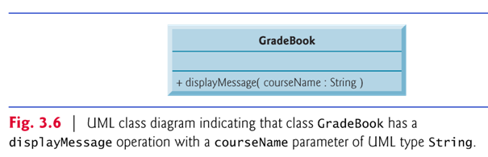
The UML class diagram of Fig. 3.6 models class GradeBook of Fig. 3.4.
The UML models a parameter by listing the parameter name, followed by a colon and the parameter type in the parentheses following the operation name.
The UML type String corresponds to the Java type String.

Slide 24
Notes on import Declarations
Classes System and String are in package java.lang
Implicitly imported into every Java program
Can use the java.lang classes without explicitly importing them
Most classes you’ll use in Java programs must be imported explicitly.
Classes that are compiled in the same directory on disk are in the same package—known as the default package.
Classes in the same package are implicitly imported into the source-code files of other classes in the same package.
An import declaration is not required if you always refer to a class via its fully qualified class name
Package name followed by a dot (.) and the class name.
Example: java.util.Scanner

Slide 25
3.4 Instance Variables, set Methods and get Methods
Local variables
Variables declared in the body of a particular method.
When a method terminates, the values of its local variables are lost.
c.f., Instance variables
Recall from Section 3.2 that an object has attributes that are carried with the object as it’s used in a program.
Such attributes exist before a method is called on an object and after the method completes execution.
Declared inside a class declaration but outside the bodies of the class’s method declarations.
Exercise: List the local and the instance variables in the sample program (Figure 3) of lab 1.

Slide 26
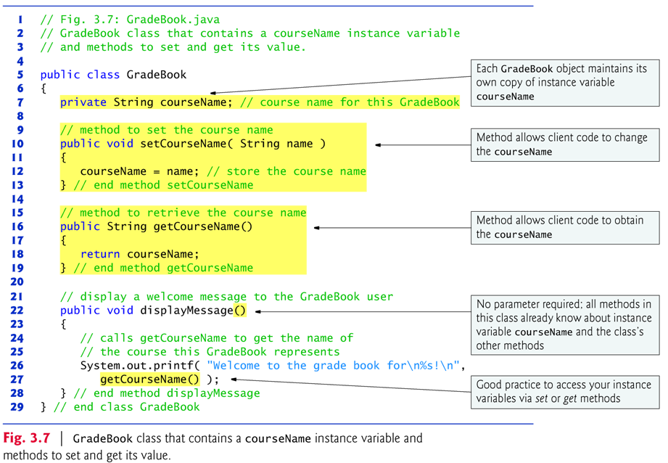
Revised GradeBook.java class

Slide 27
Instance variables (cont.)
Every instance (i.e., object) of a class contains one copy of each instance variable.
Instance variables typically declared private.
private is an access modifier.
private variables and methods are accessible only to methods of the class in which they are declared.
Declaring instance private is known as data hiding or information hiding.
Prevents instance variables from being modified accidentally by a class in another part of the program.
To access instance variables, use set and get methods.

Slide 28
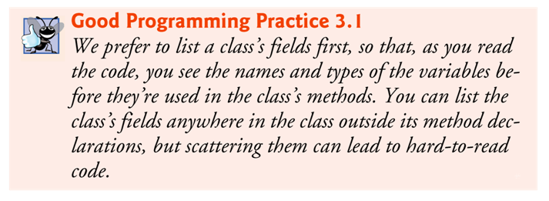
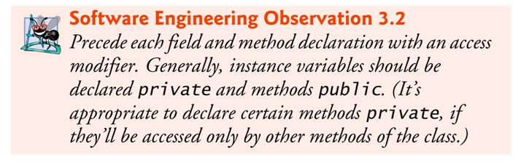

Slide 29
set and get methods
A class’s private fields can be manipulated only by the class’s methods.
A client of an object calls the class’s public methods to manipulate the private fields of an object of the class.
Classes often provide public methods to allow clients to set (i.e., assign values to) or get (i.e., obtain the values of) private instance variables.
The names of these methods need not begin with set or get, but this naming convention is recommended.

Slide 30
More on methods:
When a method that specifies a return type other than void completes its task, the method returns a result to its calling method.
Typically, set methods returns void, while get methods returns something.
One method of a class can call another method of the same class by using just the method name.

Slide 31
Initialization of instance variables:
Unlike local variables, which are not automatically initialized, every instance variable has a default initial value — a value provided by Java when you do not specify the field’s initial value.
Instance variables are not required to be explicitly initialized before they are used in a program — unless they must be initialized to values other than their default values.
The default value for a field of type String is null, for int is 0, and for boolean is false.
Instance variables are often initialized in that class’s constructor methods. (More later; also see http://download.oracle.com/javase/tutorial/java/javaOO/initial.html)

Slide 32
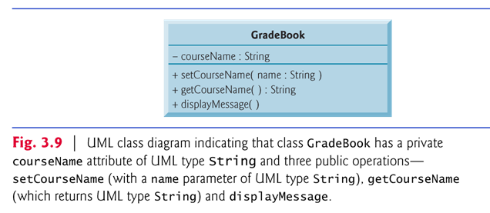
Figure 3.9 contains an updated UML class diagram for the version of class GradeBook in Fig. 3.7.
Models instance variable courseName as an attribute in the middle compartment of the class.
The UML represents instance variables as attributes by listing the attribute name, followed by a colon and the attribute type.
A minus sign (–) access modifier corresponds to access modifier private.

Slide 33
3.5 Primitive Types vs. Reference Types
Types are divided into primitive types and reference types.
The primitive types are boolean, byte, char, short, int, long, float and double.
All non-primitive types are reference types.
A primitive-type variable can store exactly one value of its declared type at a time.
Primitive-type instance variables are initialized by default — variables of types byte, char, short, int, long, float and double are initialized to 0, and variables of type boolean are initialized to false.
You can specify your own initial value for a primitive-type variable by assigning the variable a value in its declaration.

Slide 34
Variables of reference types:
Programs use variables of reference types (normally called references) to store the locations of objects in the computer’s memory.
Such a variable is said to refer to an object in the program.
Objects that are referenced may each contain many instance variables and methods.
Reference-type instance variables are initialized by default to the value null
A reserved word that represents a “reference to nothing.”
When using an object of another class, a reference to the object is required to invoke (i.e., call) its methods.
Also known as sending messages to an object.

Slide 35
3.6 Initializing Objects with Constructors
When an object of a class is created, its instance variables are initialized by default.
Each class can provide a constructor that initializes an object of that class.
Java requires a constructor call for every object that is created.
Keyword new requests memory from the system to store an object, then calls the corresponding class’s constructor to initialize the object.
A constructor must have the same name as the class.

Slide 36
By default, the compiler provides a default constructor with no parameters in any class that does not explicitly include a constructor.
Instance variables are initialized to their default values.
Can provide your own constructor to specify custom initialization for objects of your class.
A constructor’s parameter list specifies the data it requires to perform its task.
Constructors cannot return values, so they cannot specify a return type.
Normally, constructors are declared public.
If you declare any constructors for a class, the Java compiler will not create a default constructor for that class.

Slide 37
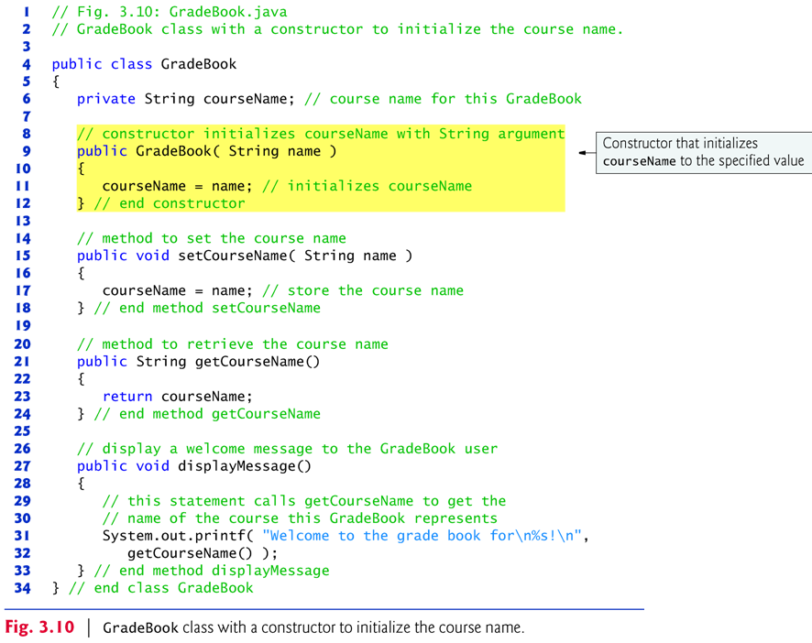

Slide 38
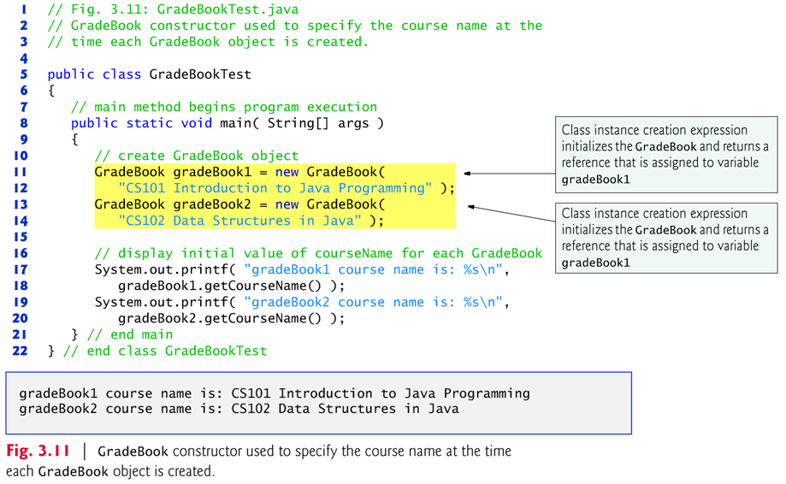

Slide 39
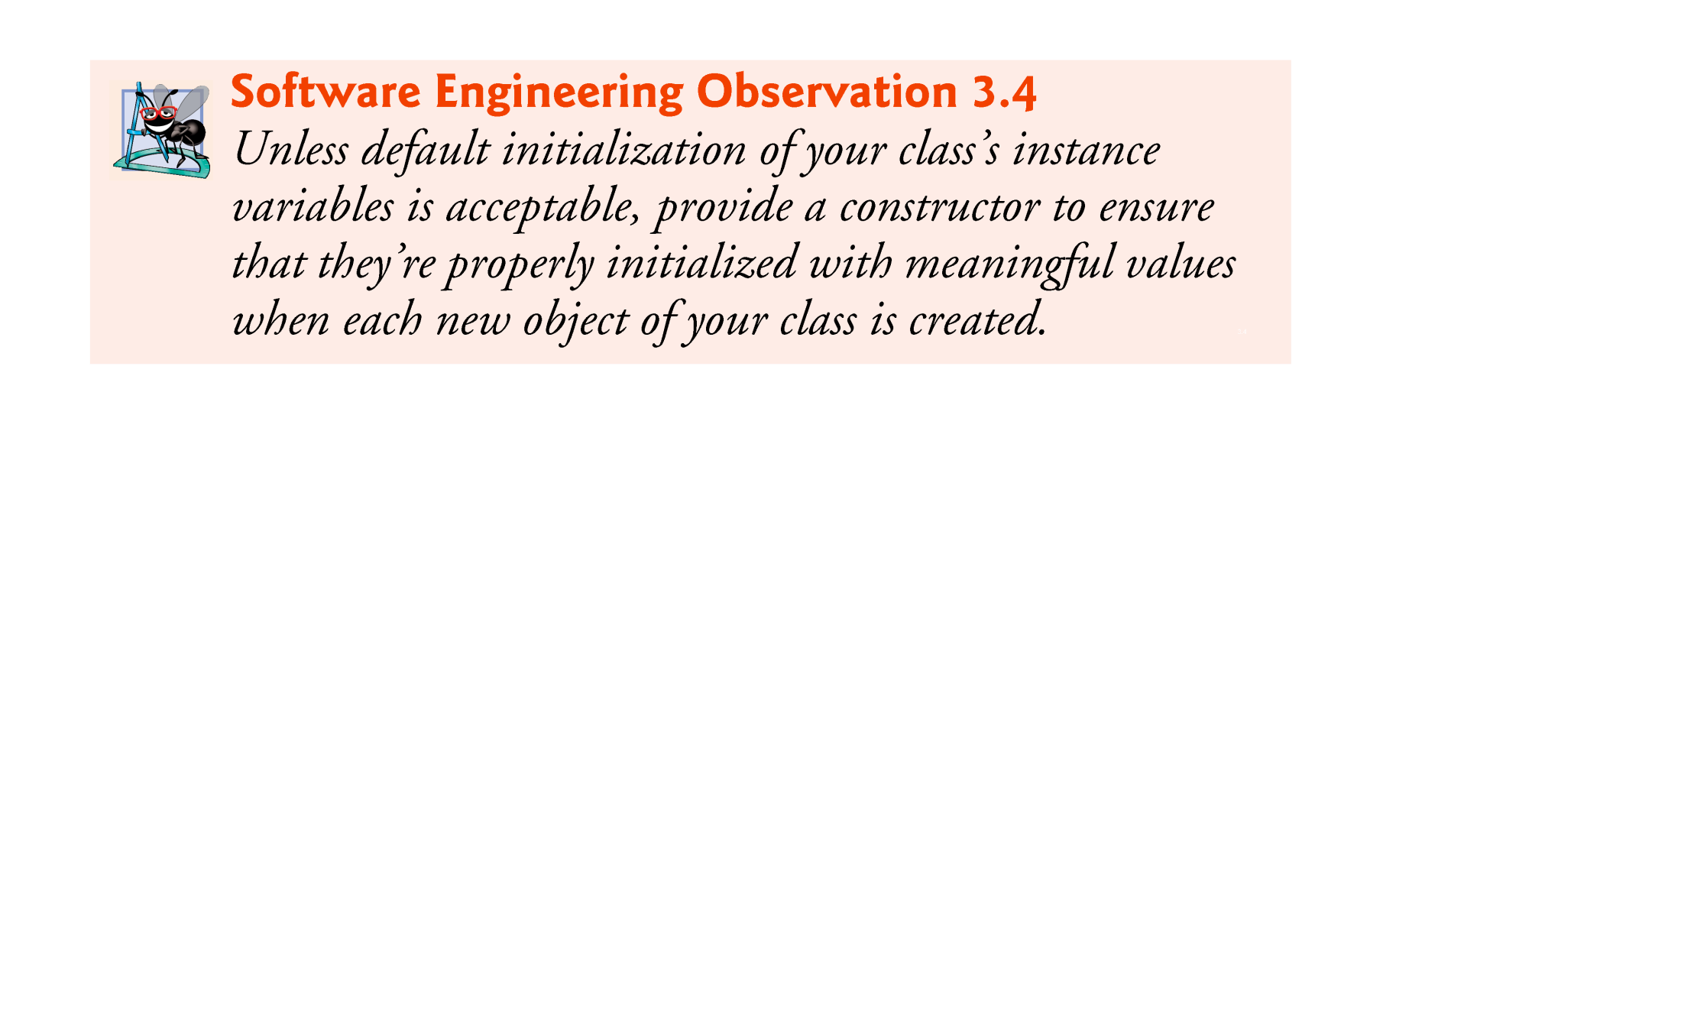

Slide 40
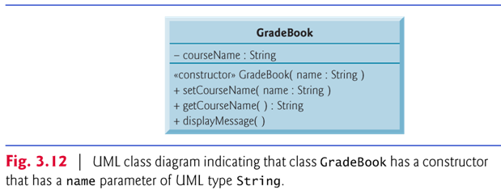
The UML class diagram of Fig. 3.12 models class GradeBook of Fig. 3.10, which has a constructor that has a name parameter of type String.
Like operations, the UML models constructors in the third compartment of a class in a class diagram.
To distinguish a constructor, the UML requires that the word “constructor” be placed between guillemets (« and ») before the constructor’s name.
List constructors before other operations in the third compartment.

Slide 41
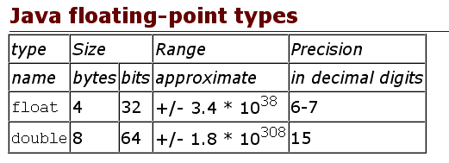
3.7 float and double
Floating-point numbers
A number with a decimal point, such as 7.33, 0.0975 or 1000.12345).
See http://en.wikipedia.org/wiki/Floating_point for details.
Java’s float and double primitive types
float represents single-precision floating-point numbers.
double represents double-precision floating-point numbers.
source: http://www.leepoint.net/notes-java/data/basic_types/22floatingpoint.html

Slide 42
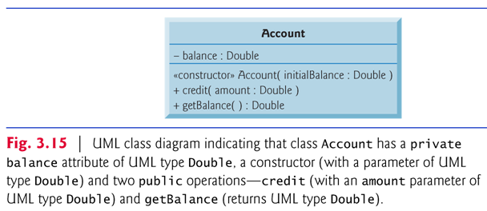
A new class: Account
The UML class diagram in Fig. 3.15 models class Account of Fig. 3.13.

Slide 43
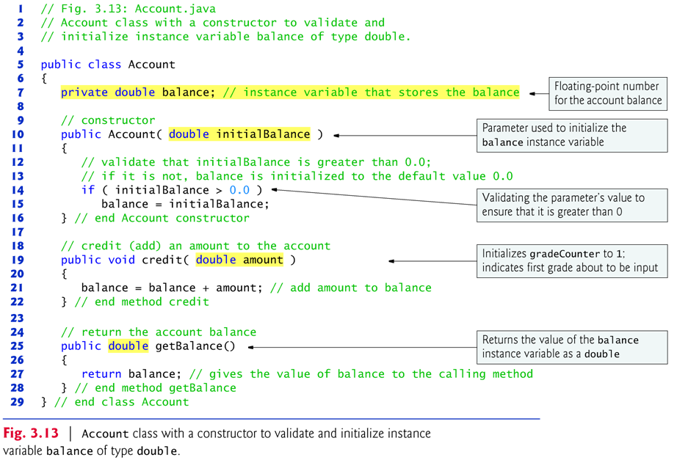

Slide 44
Use System.out.printf to print floating point numbers:
Format specifier %.2f
%f is used to output values of type float or double.
.2 represents the number of decimal places (2) to output to the right of the decimal point—known as the number’s precision.
Any floating-point value output with %.2f will be rounded to the hundredths position.
Scanner method nextDouble( ) returns a double value entered by the user.

Slide 45
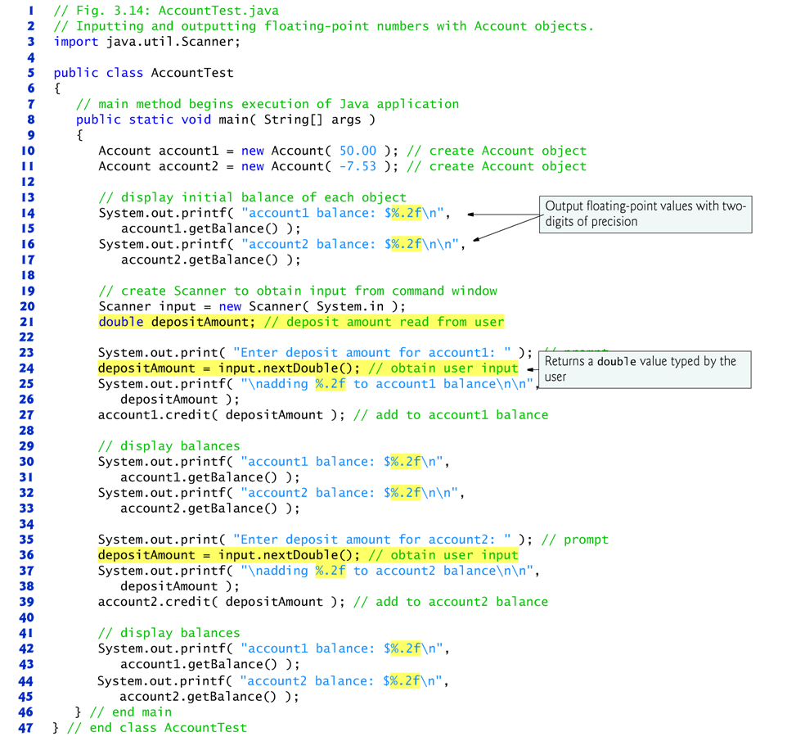
A driver program to test the Account.java class
- Fig. 3.14: AccountTest.java

Slide 46
3.8 (Optional) GUI and Graphics Case Study: Using Dialog Boxes
Many applications use windows or dialog boxes (also called dialogs) to display output.
Typically, dialog boxes are windows in which programs display important messages to users.
Class javax.swing.JOptionPane provides prebuilt dialog boxes that enable programs to display windows containing messages — such windows are called message dialogs.

Slide 47
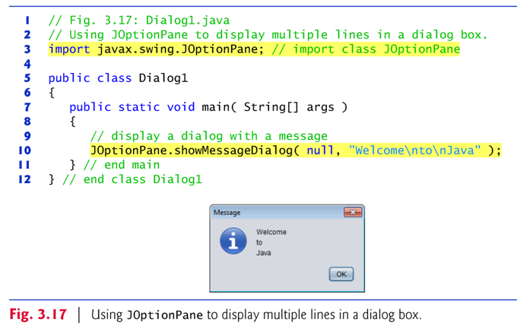

Slide 48
Package javax.swing contains many classes that help you create graphical user interfaces (GUIs).
GUI components facilitate data entry by a program’s user and presentation of outputs to the user.
JOptionPane method showMessageDialog( ) displays a dialog box containing a message.
Requires two arguments.
The first helps the Java application determine where (in which window) to position the dialog box.
If the first argument is null, the dialog box is displayed at the center of your screen.
The second argument is the String to display in the dialog box.

Slide 49
JOptionPane method showMessageDialog is a static method.
Such methods often define frequently used tasks.
Typically called by using method’s class name followed by a dot (.) and the method name, as in
ClassName.methodName( arguments )
Notice that you do not create an object of class JOptionPane to use its static method showMessageDialog.

Slide 50
Input Dialog
An input dialog allows the user to enter data into a program.
JOptionPane method showInputDialog( ) displays an input dialog.
Contains a prompt and a field (known as a text field) in which the user can enter text.
Returns a String containing the characters typed by the user.

Slide 51
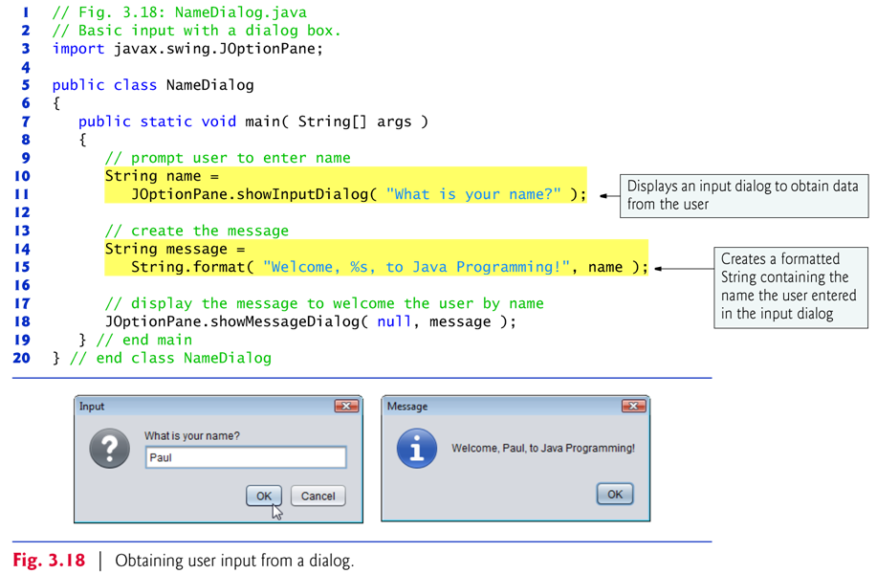

Slide 52
String method format( ) returns a formatted String.
Method format( ) works like method System.out.printf, except that format returns the formatted String rather than displaying it in a command window.

Slide 53
